Slide 1
Processor Structure and Function

Slide 2
Contents
Number System
Computer Arithmetic
Instruction Set
Addressing Modes
Processor – Structure & Function
Instruction Pipelining
RISC and CISC

Slide 3
Processor Organization Processor Requirements
Fetch instruction
The processor reads an instruction from memory (register, cache, main memory)
Interpret instruction
The instruction is decoded to determine what action is required
Fetch data
The execution of an instruction may require reading data from memory or an I/O module
Process data
The execution of an instruction may require performing some arithmetic or logical operation on data
Write data
The results of an execution may require writing data to memory or an I/O module
In order to do these things the processor needs to store some data temporarily and therefore needs a small internal memory
Notes:
22
To understand the organization of the processor, let us consider the requirements placed on the processor, the things that it must do:
Fetch instruction: The processor reads an instruction from memory (register, cache, main memory).
Interpret instruction: The instruction is decoded to determine what action is required.
Fetch data: The execution of an instruction may require reading data from memory or an I/O module.
Process data: The execution of an instruction may require performing some arithmetic or logical operation on data.
Write data: The results of an execution may require writing data to memory or an I/O module.
To do these things, it should be clear that the processor needs to store some data temporarily. It must remember the location of the last instruction so that it can know where to get the next instruction. It needs to store instructions and data temporarily while an instruction is being executed. In other words, the processor needs a small internal memory.

Slide 4
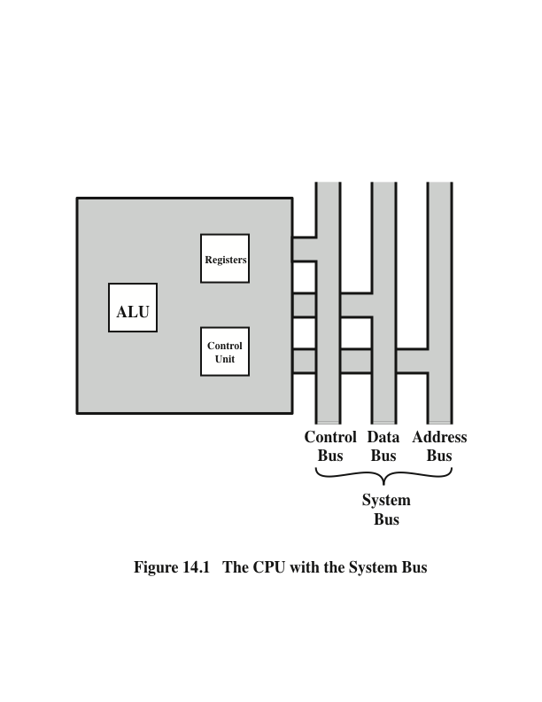
CPU With the System Bus
Notes:
Figure 14.1 is a simplified view of a processor, indicating its connection to the rest of the system via the system bus. A similar interface would be needed for any of the interconnection structures described in Chapter 3. The reader will recall that the major components of the processor are an arithmetic and logic unit (ALU) and a control unit (CU). The ALU does the actual computation or processing of data. The control unit controls the movement of data and instructions into and out of the processor and controls the operation of the ALU. In addition, the figure shows a minimal internal memory, consisting of a set of storage locations, called registers.

Slide 5
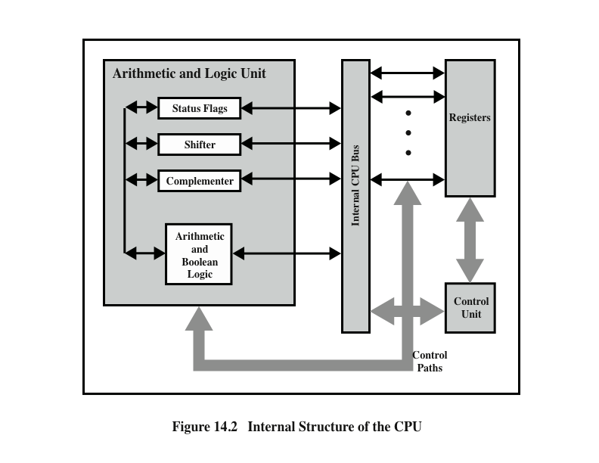
CPU Internal Structure
Notes:
Figure 14.2 is a slightly more detailed view of the processor. The data transfer and logic control paths are indicated, including an element labeled internal
processor bus. This element is needed to transfer data between the various registers and the ALU because the ALU in fact operates only on data in the internal processor memory. The figure also shows typical basic elements of the ALU. Note the similarity between the internal structure of the computer as a whole and the internal structure of the processor. In both cases, there is a small collection of major elements (computer: processor, I/O, memory; processor: control unit, ALU, registers) connected by data paths.

Slide 6
Register Organization
Within the processor there is a set of registers. The registers in the processor perform two roles:
User Visible Registers
Enable the machine or assembly language programmer to minimize main memory references by optimizing use of registers.
Control and Status Registers
Used by the control unit to control the operation of the processor. OS programs may also use these in privileged modes to control the execution of program.

Slide 7
User Visible Registers
Referenced by means of the machine language that the processor executes.
Categories:
General purpose
Data
Address
Condition codes (flags)
Bits set by the processor hardware as the result of operations

Slide 8
Control and Status Registers
Four registers are essential to instruction execution:
Program counter (PC)
Instruction register (IR)
Memory address register (MAR)
Memory buffer register (MBR)
Program Status Word (PSW)
Register or set of registers that contain status information and condition codes
Common fields or flags include:
Sign
Zero
Carry
Equal
Overflow
Interrupt Enable/Disable
Notes:
30
There are a variety of processor registers that are employed to control the operation of the processor. Most of these, on most machines, are not visible to the user. Some of them may be visible to machine instructions executed in a control or operating system mode.
Of course, different machines will have different register organizations and use different terminology. We list here a reasonably complete list of register types, with a brief description.
Four registers are essential to instruction execution:
Program counter (PC): Contains the address of an instruction to be fetched.
Instruction register (IR): Contains the instruction most recently fetched.
Memory address register (MAR): Contains the address of a location in memory.
Memory buffer register (MBR): Contains a word of data to be written to memory or the word most recently read.
Not all processors have internal registers designated as MAR and MBR, but some equivalent buffering mechanism is needed whereby the bits to be transferred to the system bus are staged and the bits to be read from the data bus are temporarily stored.
Typically, the processor updates the PC after each instruction fetch so that the PC always points to the next instruction to be executed. A branch or skip instruction will also modify the contents of the PC. The fetched instruction is loaded into an IR, where the opcode and operand specifiers are analyzed. Data are exchanged with memory using the MAR and MBR. In a bus- organized system, the MAR connects directly to the address bus, and the MBR connects directly to the data bus. User-visible registers, in turn, exchange data with the MBR.
The four registers just mentioned are used for the movement of data between the processor and memory. Within the processor, data must be presented to the ALU for processing. The ALU may have direct access to the MBR and user-visible registers. Alternatively, there may be additional buffering registers at the boundary to the ALU; these registers serve as input and output registers for the ALU and exchange data with the MBR and user-visible registers.

Slide 9
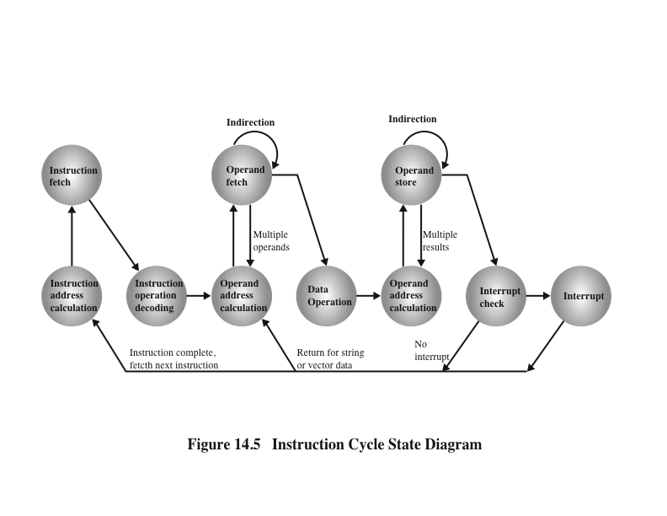
Instruction Cycle State Diagram
Notes:
Another way to view this process is shown in Figure 14.5, which is a revised version of Figure 3.12. This illustrates more correctly the nature of the instruction cycle. Once an instruction is fetched, its operand specifiers must be identified. Each input operand in memory is then fetched, and this process may require indirect addressing. Register-based operands need not be fetched. Once the opcode is executed, a similar process may be needed to store the result in main memory.

Slide 10
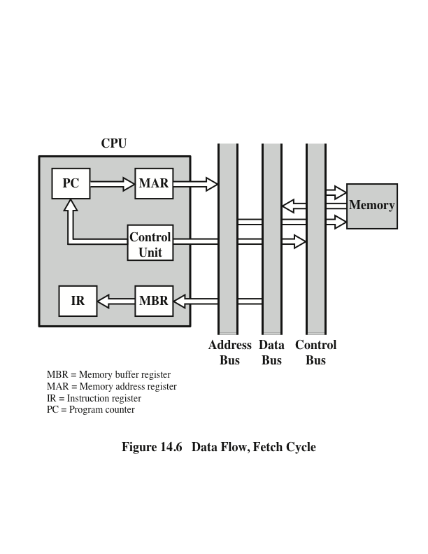
Data Flow, Fetch Cycle
Notes:
The exact sequence of events during an instruction cycle depends on the design of the processor. We can, however, indicate in general terms what must happen. Let us assume that a processor that employs a memory address register (MAR), a memory buffer register (MBR), a program counter (PC), and an instruction register (IR).
During the fetch cycle, an instruction is read from memory. Figure 14.6 shows the flow of data during this cycle. The PC contains the address of the next instruction to be fetched. This address is moved to the MAR and placed on the address bus. The control unit requests a memory read, and the result is placed on the data bus and copied into the MBR and then moved to the IR. Meanwhile, the PC is incremented by 1, preparatory for the next fetch.

Slide 11
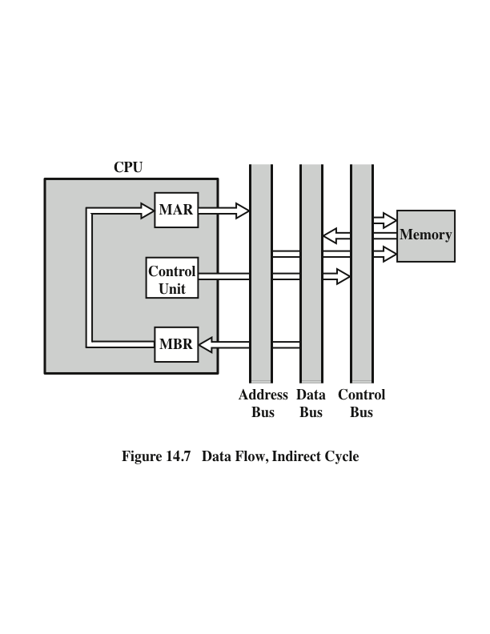
Data Flow, Indirect Cycle
Notes:
Once the fetch cycle is over, the control unit examines the contents of the IR to determine if it contains an operand specifier using indirect addressing. If so, an indirect cycle is performed. As shown in Figure 14.7, this is a simple cycle. The right- most N bits of the MBR, which contain the address reference, are transferred to the MAR. Then the control unit requests a memory read, to get the desired address of the operand into the MBR.
The fetch and indirect cycles are simple and predictable. The execute cycle takes many forms; the form depends on which of the various machine instructions is in the IR. This cycle may involve transferring data among registers, read or write from memory or I/O, and/or the invocation of the ALU.

Slide 12
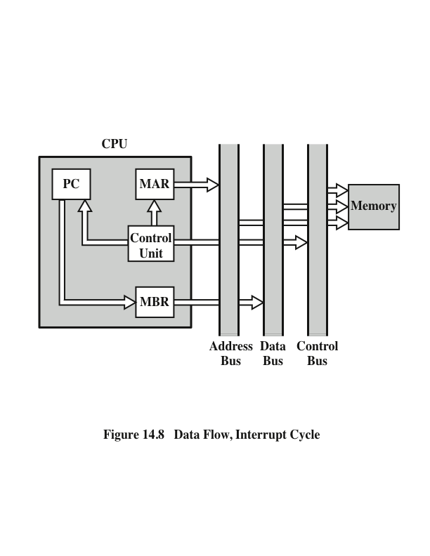
Data Flow, Interrupt Cycle
Notes:
Like the fetch and indirect cycles, the interrupt cycle is simple and predictable (Figure 14.8). The current contents of the PC must be saved so that the processor can resume normal activity after the interrupt. Thus, the contents of the PC are transferred to the MBR to be written into memory. The special memory location reserved for this purpose is loaded into the MAR from the control unit. It might, for example, be a stack pointer. The PC is loaded with the address of the interrupt routine. As a result, the next instruction cycle will begin by fetching the appropriate instruction.

Slide 13
Instruction Pipelining

Slide 14
Pipelining Strategy
Similar to the use of an assembly line in a manufacturing plant.
New inputs are accepted at one end before previously accepted inputs appear as outputs at the other end.
To apply this concept to instruction execution we must recognize that an instruction has a number of stages.
Instruction pipelining is a technique used in the design of modern CPUs to increase their instruction throughput:
involves number of steps, where each step completes a part of an instruction. Each step is called a pipeline stage.
increases the CPU instruction throughput - no. of instructions completed per cycle (unit of time).

Slide 15
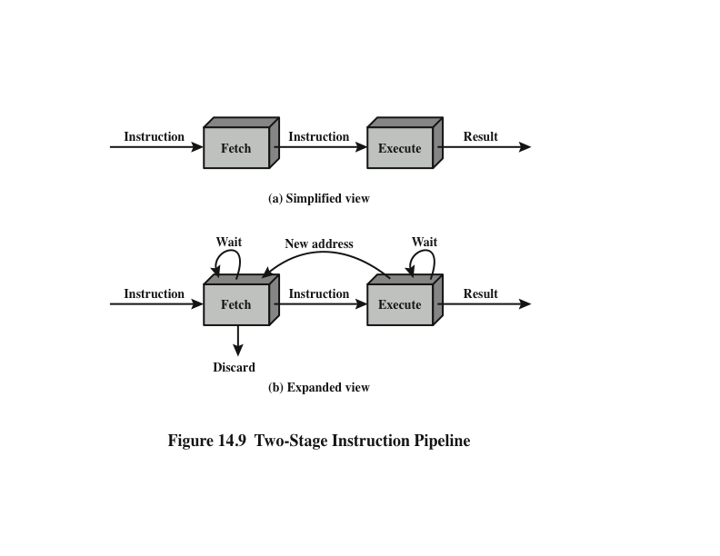
Two-Stage Instruction Pipeline
Notes:
As a simple approach, consider subdividing instruction processing into two stages: fetch instruction and execute instruction. There are times during the execution of an instruction when main memory is not being accessed. This time could be used to fetch the next instruction in parallel with the execution of the current one. Figure 14.9a depicts this approach. The pipeline has two independent stages. The first stage fetches an instruction and buffers it. When the second stage is free, the first stage passes it the buffered instruction. While the second stage is executing the instruction, the first stage takes advantage of any unused memory cycles to fetch and buffer the next instruction. This is called instruction prefetch or fetch overlap. Note that this approach, which involves instruction buffering, requires more registers. In general, pipelining requires registers to store data between stages.
It should be clear that this process will speed up instruction execution. If the fetch and execute stages were of equal duration, the instruction cycle time would be halved. However, if we look more closely at this pipeline (Figure 14.9b), we will see that this doubling of execution rate is unlikely for two reasons:
The execution time will generally be longer than the fetch time. Execution will involve reading and storing operands and the performance of some operation. Thus, the fetch stage may have to wait for some time before it can empty its buffer.
A conditional branch instruction makes the address of the next instruction to be fetched unknown. Thus, the fetch stage must wait until it receives the next instruction address from the execute stage. The execute stage may then have to wait while the next instruction is fetched.
Guessing can reduce the time loss from the second reason. A simple rule is the following: When a conditional branch instruction is passed on from the fetch to the execute stage, the fetch stage fetches the next instruction in memory after the branch instruction. Then, if the branch is not taken, no time is lost. If the branch is taken, the fetched instruction must be discarded and a new instruction fetched.

Slide 16
Pipeline Stages
Fetch instruction (FI)
Decode instruction (DI)
Calculate operands (CO)
Fetch operands (FO)
Execute instruction (EI)
Write operand (WO)

Slide 17
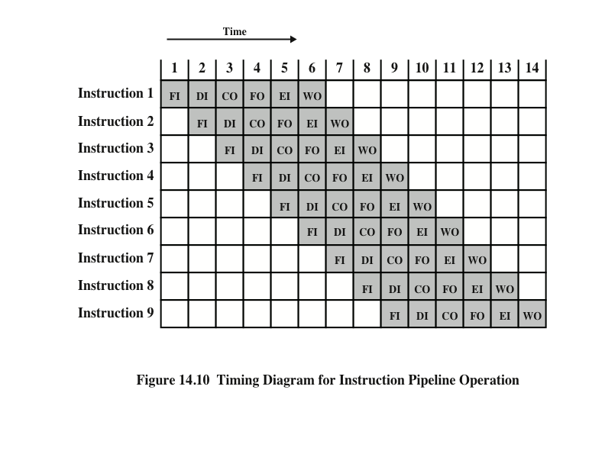
Timing Diagram for Instruction Pipeline Operation
Notes:
39
For the sake of illustration, let us assume equal duration. Using this assumption, Figure 14.10 shows that a six-stage pipeline can reduce the execution time for 9 instructions from 54 time units to 14 time units.
Several comments are in order: The diagram assumes that each instruction goes through all six stages of the pipeline. This will not always be the case. For example, a load instruction does not need the WO stage. However, to simplify the pipeline hardware, the timing is set up assuming that each instruction requires all six stages. Also, the diagram assumes that all of the stages can be performed in parallel. In particular, it is assumed that there are no memory conflicts. For example, the FI, FO, and WO stages involve a memory access. The diagram implies that all these accesses can occur simultaneously. Most memory systems will not permit that. However, the desired value may be in cache, or the FO or WO stage may be null. Thus, much of the time, memory conflicts will not slow down the pipeline.

Slide 18
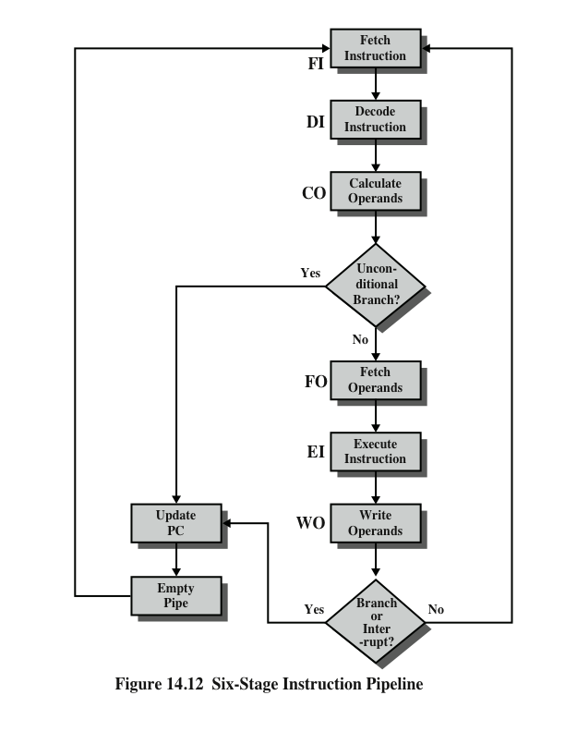
Six Stage Instruction Pipeline
Notes:
Figure 14.12 indicates the logic needed for pipelining to account for branches and interrupts.
Other problems arise that did not appear in our simple two-stage organization. The CO stage may depend on the contents of a register that could be altered by a previous instruction that is still in the pipeline. Other such register and memory conflicts could occur. The system must contain logic to account for this type of conflict.

Slide 19
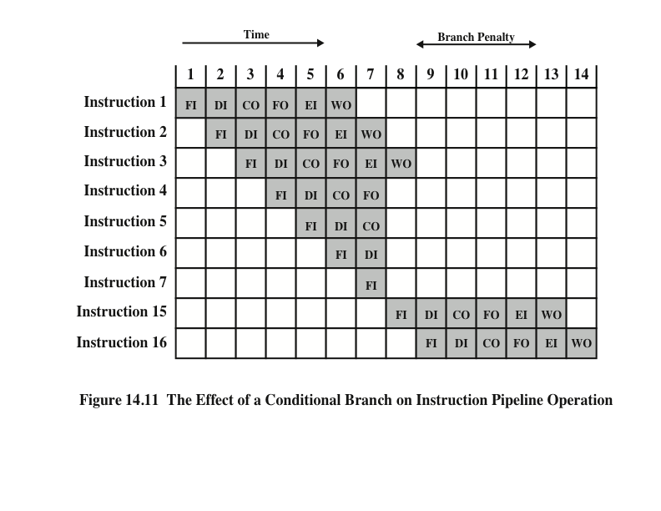
Effect of Conditional Branch on Instruction Pipeline Operation
Notes:
40
Several other factors serve to limit the performance enhancement. If the six stages are not of equal duration, there will be some waiting involved at various pipe- line stages, as discussed before for the two-stage pipeline. Another difficulty is the conditional branch instruction, which can invalidate several instruction fetches. A similar unpredictable event is an interrupt. Figure 14.11 illustrates the effects of the conditional branch, using the same program as Figure 14.10. Assume that instruction 3 is a conditional branch to instruction 15. Until the instruction is executed, there is no way of knowing which instruction will come next. The pipeline, in this example, simply loads the next instruction in sequence (instruction 4) and proceeds. In Figure 14.10, the branch is not taken, and we get the full performance benefit of the enhancement. In Figure 14.11, the branch is taken. This is not determined until the end of time unit 7. At this point, the pipeline must be cleared of instructions that are not useful. During time unit 8, instruction 15 enters the pipeline. No instructions complete during time units 9 through 12; this is the performance penalty incurred because we could not anticipate the branch.

Slide 20
Pipeline Hazards
Occur when the pipeline, or some portion of the pipeline, must stall because conditions do not permit continued execution.
Also referred to as a pipeline bubble.
There are three types of hazards:
Resource
Data
Control

Slide 21
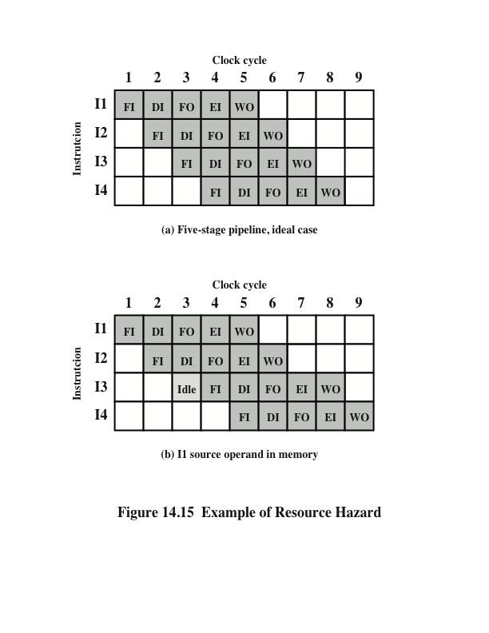
Resource Hazards
A resource hazard occurs when two or more instructions that are already in the pipeline need the same resource.
Instructions must be executed in serial rather than parallel for a portion of the pipeline.
Also referred to as a structural hazard.

Slide 22
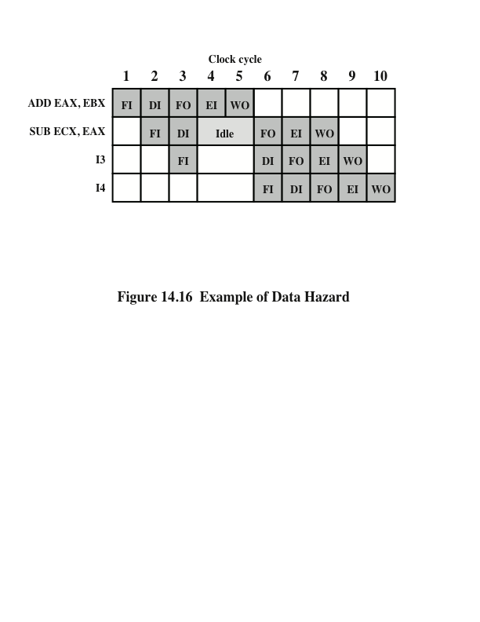
Data Hazards
A data hazard occurs when there is a conflict in the access of an operand location.
Read after write (RAW)
Write after read (WAR)
Write after write (WAW)
RAW Hazard

Slide 23
Control Hazard
Also known as a branch hazard.
Occurs when the pipeline makes the wrong decision on a branch prediction.
Brings instructions into the pipeline that must subsequently be discarded.
Notes:
A control hazard, also known as a branch hazard, occurs when the pipeline makes the wrong decision on a branch prediction and therefore brings instructions into the pipeline that must subsequently be discarded. We discuss approaches to dealing with control hazards next.
One of the major problems in designing an instruction pipeline is assuring a steady flow of instructions to the initial stages of the pipeline. The primary impediment, as we have seen, is the conditional branch instruction. Until the instruction is actually executed, it is impossible to determine whether the branch will be taken or not.
A variety of approaches have been taken for dealing with conditional branches:
Multiple streams
Prefetch branch target
Loop buffer
Branch prediction
Delayed branch

Slide 24
Reference
Computer Organization and Architecture: Designing for Performance, William Stallings, 9th Edition, Pearson India, 2013.

